Slide 1




Slide 2
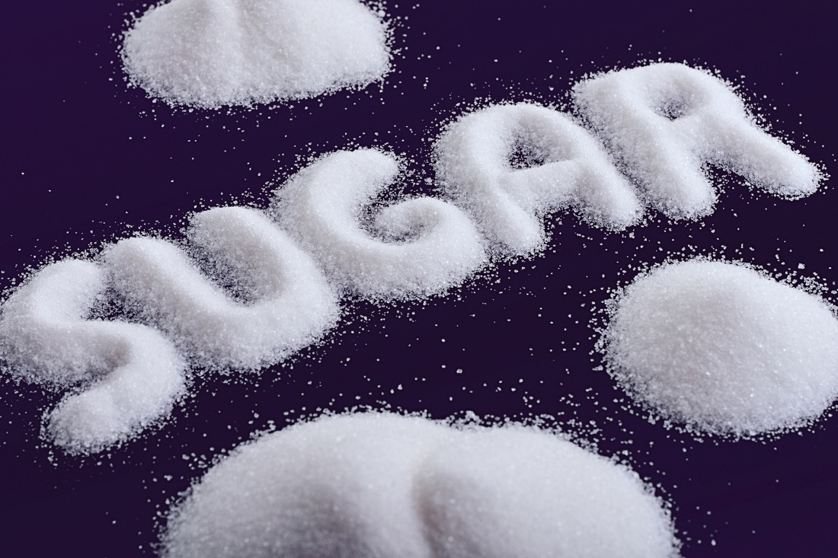
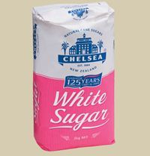
Notes:
There has been a lot of talk about sugar and sugary drinks recently –
What have you heard?
What do you think?

Slide 3
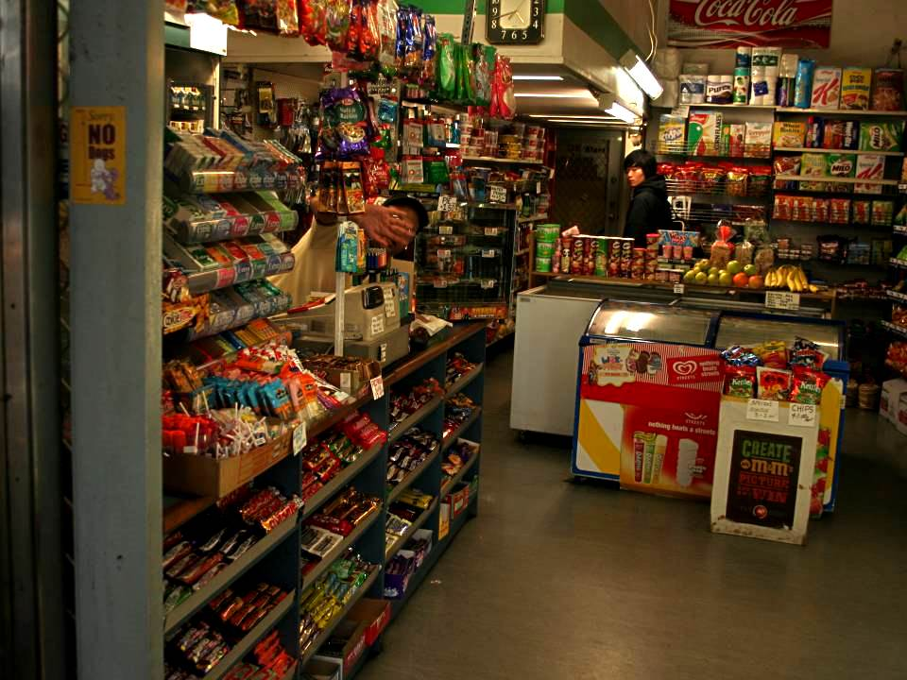
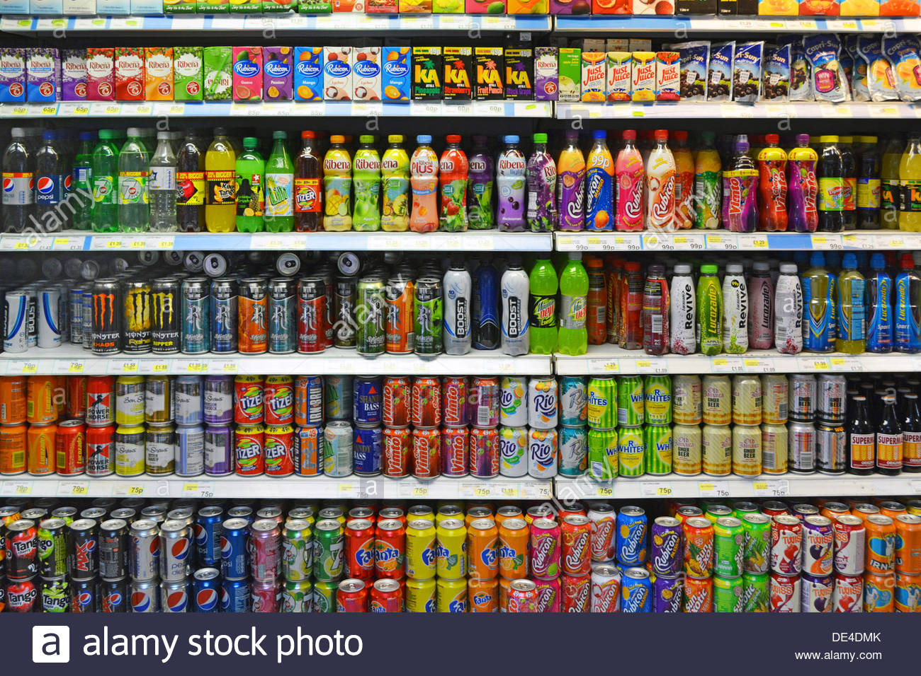
What are the main sources of sugar?

Slide 4
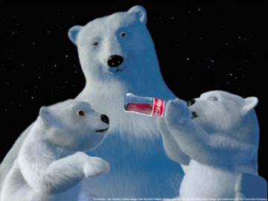
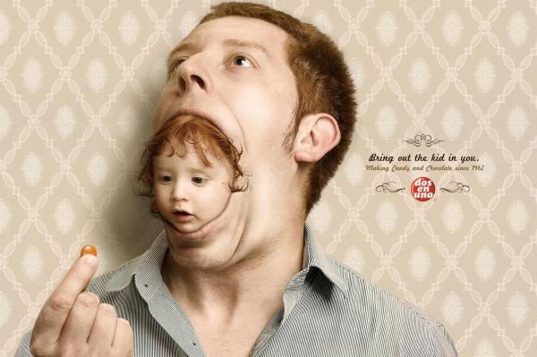

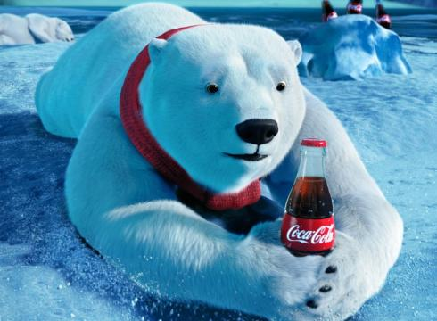
What do you think business want us to think about sugary porducts/drinks? Why?
Sports / musicians / youth / fun / beautiful / ehalthy

Slide 5


Slide 6
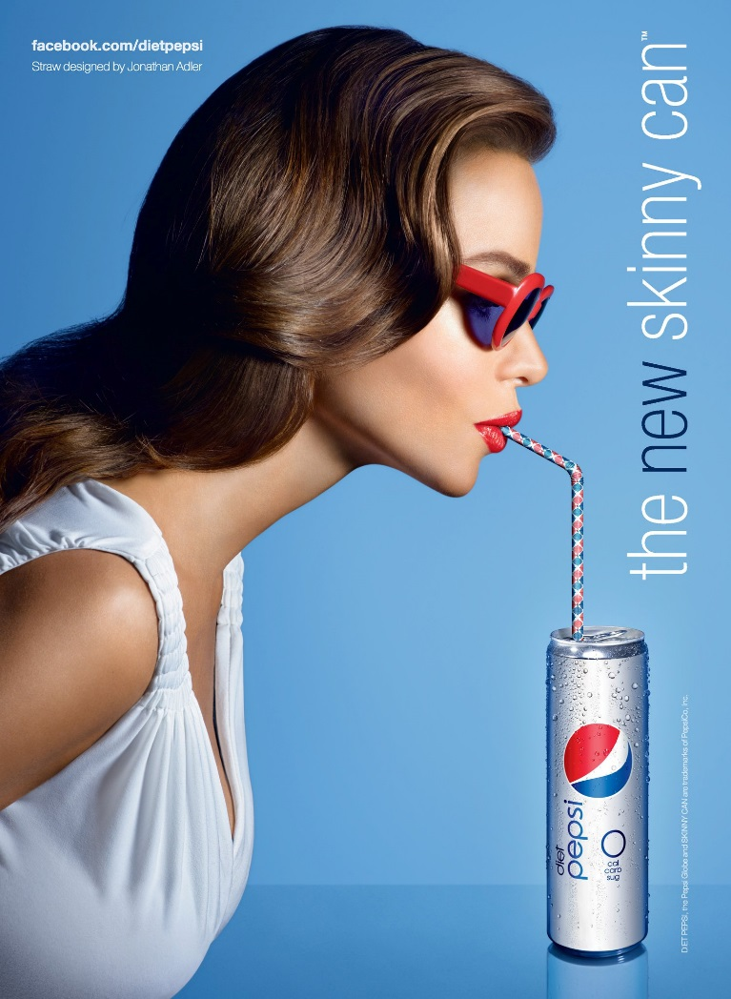



Slide 7
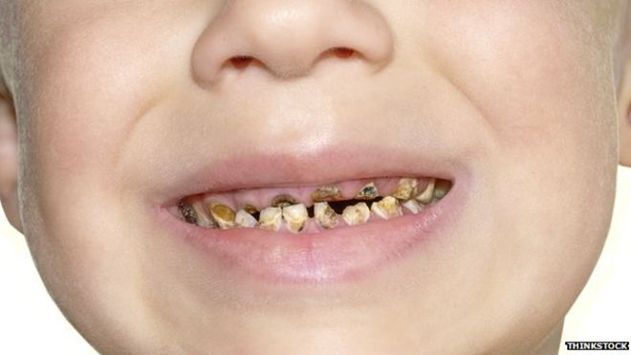
Whwat is the reality?
Images of:
Dental decay,
Diabetes
Unhealthy weight
etc

Slide 8
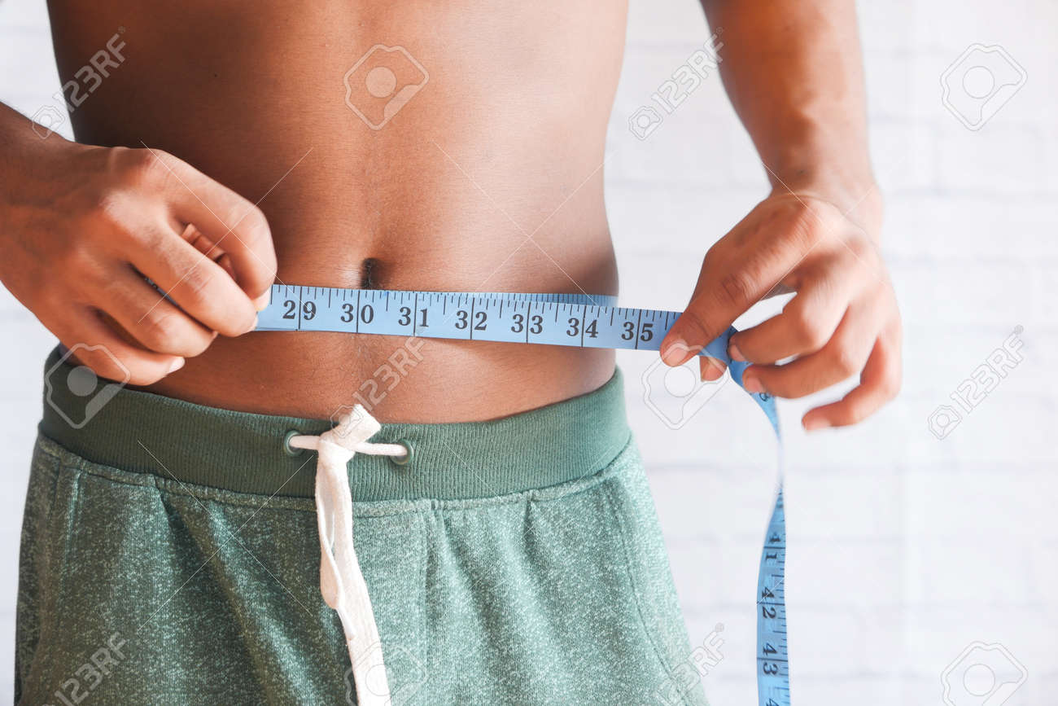
Images of:
Dental decay,
Diabetes
Unhealthy weight
etc
Unhealthy Weight

Slide 9
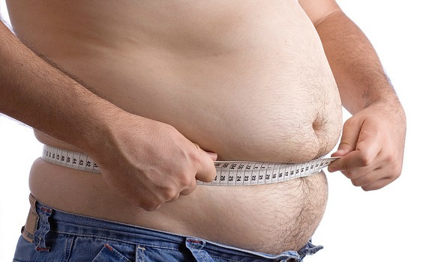

Whwat is the reality?
Other Health Problems
High blood pressure
Gout
Some Cancers
Behavioural disorders
Poor concentration
CVD / Heart disease
Learning difficulties
Images of:
Dental decay,
Diabetes
Unhealthy weight
etc

Slide 10
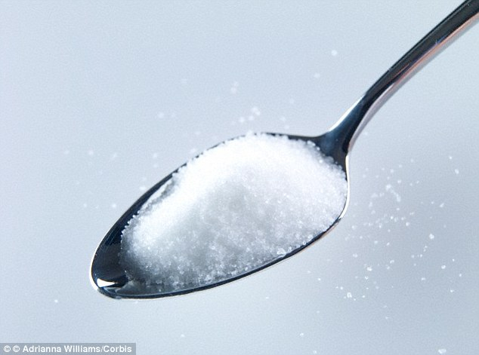
= g
4
A teaspoon of SUGAR

Slide 11




How many teaspoons of sugar is the MAXIMUM daily allowance?
3 6 9

